Slide 1


Slide 2
Requirements

Slide 3
Facilitated Application Specification Techniques(FAST)
FAST can replace a series of interviews with the user community
FAST is a technique that allows the analyst to accomplish requirements analysis and design the user interface with the users in a group setting
A team oriented approach to requirements gathering applied during the early stages of analysis and specification

Slide 4

This approach encourages the creation of a joint team of customers and developers who work together to identify the problem propose elements of the solution, negotiate different approaches and specify a preliminary set of solution requirements.

Slide 5
Guidelines
A meeting is conducted at a neutral site and attended by both software engineers and customers.
Rules for preparation and participation are established.
An agenda is suggested that is formal enough to cover all important points but informal enough to encourage the free flow of ideas.
A “facilitator” controls the meeting.
A “definition mechanism” is used.
The goal is to identify the problem, propose elements of the solution, negotiate different approaches, and specify a preliminary set of solution requirements in an atmosphere that is conducive to the accomplishment of the goal.

Slide 6
Initial meetings between the developer and customer occur and basic questions and answers help to establish the scope of the problem and overall perception of a solution.
Out of these initial meetings the developer and customer write a one-or-two page “product request”
A meeting place, time, and date for FAST are selected and a facilitator is chosen.
Attendees from both the development and customer/user organizations are invited to attend.
The product request is distributed to all attendees before the meeting date.

Slide 7
Make a list of objects
Make a list of constraints
Make a list of services
List presented and pinned to the walls
Entries deleted and additions made
Consensus list made
Mini-specifications made
List of validation criteria
Complete draft specification

Slide 8

Quality Function Deployment
Definition
  A quality management technique that translates the needs of the customer into technical requirements for software
Emphasis
  Understanding of what is valuable to the customer and then deploys these values throughout the engineering process.

Slide 9
Types of Requirements-QFD
Normal requirements
Expected requirements
Exciting requirements

Slide 10
Use cases
A use case defines a goal-oriented set of interactions between external users and the system under consideration or development.

Slide 11
Use cases
Use-cases are a scenario based technique in the UML which identify the actors in an interaction and which describe the interaction itself
A set of use cases should describe all possible interactions with the system

Slide 12
Use Case Components
Actor: external person, organization, or system communicating with the system (data exchange)
System boundary: Collection of all use cases
Use case: action that is triggered by an actor or produces a result for an actor
Use case description: textual or semi-formalized description of a use case content

Slide 13
Examination system
Exams are coming up in Punjab University College of Information Technology. Preparations have already started. The deans of examination have already scheduled the examination on the PUCIT system. The professors will prepare papers and upload it on the system. At the time of examination, the students will sign in for examination and take the papers. The dean of examination can administer results on the system.

Slide 14
Examination system
Sign in for exams
Student
Prepare exams
Take exam
Administer marks
Dean
Schedule exams
Prof

Slide 15
Elevator problem
A product is to be installed to control n elevators in a building within m floors. The problem concerns the logic required to move elevators between floors according to the following constraints
Each floor , except the first floor and the top floor, has two buttons, one to request an up elevator and one to request a down elevator. These illuminates when pressed. The illumination is cancelled when an elevator visits the floor and then moves in the desired direction
Each elevator has a set of m buttons, one for each floor. These illuminates when pressed and cause the elevator to visit the corresponding floor. The illumination is cancelled when corresponding floor is visited by the elevator
There is a display window that shows the current floor being visited by the elevator
When an elevator has no request, it remains at its current floor with its door closed

Slide 16
Problem customization
Visitor have to pass through a security system, in which he has to enter a card to get authenticate before entering the elevator
There is only one elevator in the building
There are 8 floor in the building

Slide 17
Identify Actor, Goals, Use cases
Elevator
Goals
He get authentication and pass the security system
He visits the elevator and wants to move to the destination floor without interruption
Get authenticate
Start elevator
Visitor
Visit Floor

Slide 18

Decide who the users of our system are to be: ACTORS
Decide what they wish the system to do: USE CASES
Use cases replace a requirement specification
  Write use cases from a problem statement
  Or translate a requirement specification into use cases
Notes:
Use cases are a way of decomposing system functionality into smaller chunks, each focused on a single usage of the system. It forces decisions about scope; Use cases are only written for functionality within the scope. It provides small chunks of functionality, each of which can be examined to determine whether the level of detail is correct. These small chunks provide a framework in which ambiguities can be sought and removed. (Scenarios give real examples of use cases, as their creation eliminates any ambiguities.) Contradiction should be removed by describing functionality once. Over-specification is handled within individual use cases by their focus on user requirement rather than solution. Missing specification is handled by the grouping of use cases against actors. We can check that we have all the actors, and check that each has all the use cases they need. The number of actors per system should be relatively small, as should the number of use cases per actor, therefore helping completeness checks.
Actors and use cases should replace a more traditional requirements specification completely. The optimal solution is to start from a very small problem statement (one page only), and work with domain experts to create actors and use cases. If a traditional requirements document has been created, it can be processed into use cases, again with help from domain experts. There is no need to create a requirements document with this method (although there may be an external requirement to do so; for example, the customer may require one for tender purposes).

Slide 19
Actors
Anything that communicates with the system
The system
  Everything that the project has control over
Actors
  Things that the project cannot control
  If you can specify, choose, change, program and impose your will on, you have control
  Things that you control usually become classes
Notes:
Actors are any things that use or interact with our system. The system exists (or is being developed) purely and simply to support that interaction. Therefore, the single most important part of the project is to identify the actors and find out what they want. If a system has a customer or sponsor (someone who is paying for it to be developed), that customer should identify the actors and provide an information source for each. This may be in the form of someone who carries out the role of the actor, someone who knows about the role and can therefore speak on its behalf, or a specification of some kind that describes it.

Slide 20

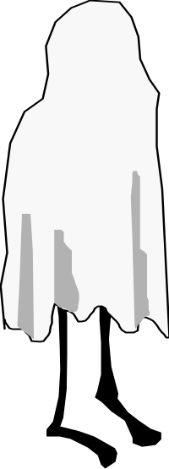
Kinds of Actors
Device
(Drink Dispenser
Cash Register
Door Lock)
Organisation
(Accounts Receivable
Tax Agency
Kitchen)
Role
(Employee
Customer
Guest)
System
(Accounting Package
Product Inventory
Bar System)
Notes:
We can subdivide the actors into different predefined categories. Investigating one category at a time can help to find less obvious actors. This could be carried further by defining subcategories: Client, Managerial, Day-to-Day, and Maintenance could be subcategories of Role.
A role is like a part in a play; people take on the role, then behave in a defined way. A role can be played my many different people, and a person can play many different roles.
An organisation is a group acting in concert, which can be treated as a single entity.
System and device actors represent software or hardware systems with which we must communicate. Differentiating between the two is rarely necessary, but listing them here and thinking of them independently may provide a better insight into what they may be.

Slide 21
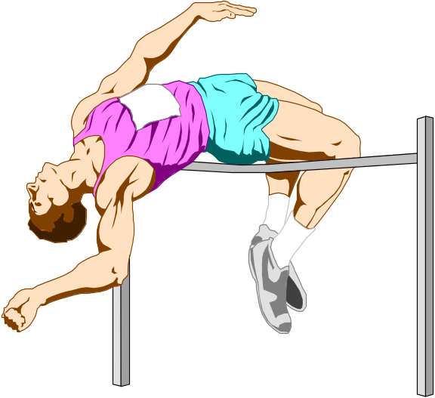
Actor
Role and Organisation actors require only logical interactions with our system
  Ask who wants something from our system, rather than who operates the system
  Customer buys food in a supermarket, not the cashier
  Guest makes a hotel reservation, not the receptionist
Actor: Competitor
Notes:
Systems should be analysed from the point of view of the actors who logically wish to use the system, rather than the physical interfaces. This should enable the system to be defined without regard to physical interface, therefore allowing different physical implementations to be bolted on. If we define our system with a cashier, it would probably be difficult to bypass the cashier later (as my local supermarket has done, with the optional use of customer-held scanners).
Having said that, there will often be separate use cases for actors who have physical interaction with the system. For example, a cashier may need to deal with a cash float, and a hotel receptionist may need to determine how many guests are due to check in during the day.
In an athletics meeting, the Competitor is an important actor, although perhaps only judges or officials may physically interact with the system.

Slide 22
Actors
Actors
  Roles that people (or devices) play as the system operates.
  Anything that communicates with the system or product and that is external to the system itself.
Types
  Primary actors-interact to achieve required system function and derive the intended benefit from the system.
  Secondary actors-support the system so that primary actors can do their work.

Slide 23
Identify high-level use cases and actors and draw high-level use case diagram.
You visit a farmhouse in the nearby area. As you reach the place, the computerized system asks you to fill in certain personal information. The system authenticates and validates your identity. The system provides and displays a complete map of the place. You can print this map if desired. The system also displays information regarding the various animals, employees etc. present in the farmhouse. You feel much confident and plan which area to visit first.

Slide 24
For the above scenario identify the normal requirements, expected requirements and exciting requirements as according to QFD
Validation of identity
Displaying of a complete map
Accurate, and secure system
Displaying information regarding animals, employees, etc.
A highly user interactive interface
System should be very easy for handling
Beyond expectations, the system also provides best possible route for visitors from information like the age, gender and interests of visitors

